Slide 1

Open Lab Series on AI in Scientific Discovery and Academic Research: ASU Tools
Namig Abbasov, Data Science Analytics Unit, ASU Library

Slide 2

Open Lab Series Schedule
15 Oct.
Introduction, Prompt Engineering
22 Oct.
LLMs for Scientific Discovery, Reasoning Models
12 Nov.
LLMs for Qualitative Research

Slide 3
Share in Chat
Which AI tools are you currently using, and which do you find most useful? Are there any general or specialized AI tools you’d like us to cover in future sessions?

Slide 4
Outline
First Review Options to Leverage LLMs
Explore AI tools provided by ASU

Slide 5
How to Leverage AI Technologies
As a user of SOTA models - Prompt Engineering
Use API
API + Retrieval Augmented Generation
Take Base Model Fine-Tuning Model
LoRA
Develop your own model

Slide 6
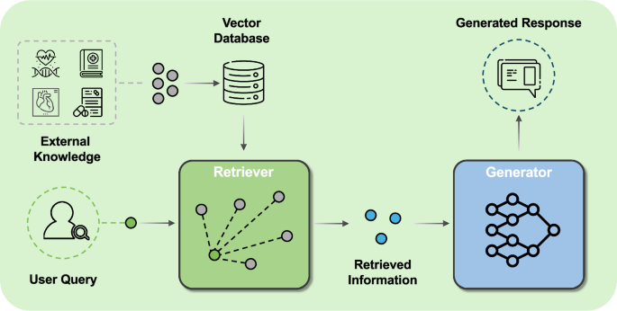
Retrieval Augmented Generation
Yang et al.2025

Slide 7
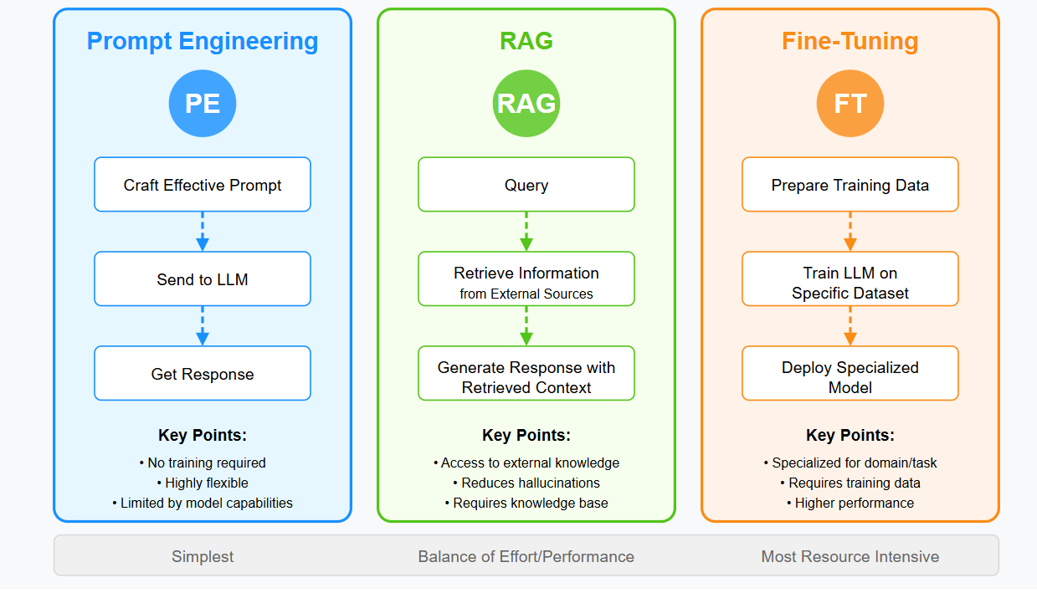
RAG vs Fine-Tuning vs Prompt Engineering

Slide 8
Artificial Intelligence at ASU
CreateAI Builder
ChatGPT Edu
Google Gemini for Education

Slide 9
ASU ChatGPT Edu
ASU Data Privacy
How to Sign Up
ASU’s Data Classification Tool
Request Additional Features

